Slide 1
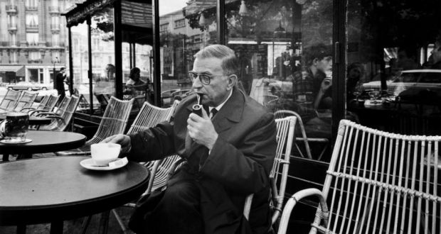
Existentialism
Gent 14
Monterey Peninsula College
Stephanie Spoto

Slide 2
Existentialism
“Existentialism is a catch-all term for those philosophers who consider the nature of the human condition as a key philosophical problem and who share the view that this problem is best addressed through ontology” (Douglas Burnham, “Existentialism,” Internet Encyclopedia of Philosophy)
Three central concerns:
Individual human beings: general theories about human nature leave out what is important about individual experience
Meaning: importance places on the meaning or purpose of human existence, rather than either scientific or metaphysical truths → inner experience more important than objective truth
Emphasis on freedom: we each have the ability to choose our actions, purpose, values, etc. We must realize our freedom and act on it.

Slide 3
Early existentialists
These philosophical themes have appeared in various philosophers in various times → to be existentialist philosopher, though, requires some analysis of the human condition
Soren Kierkegaard (1813-1855): first modern existentialist
Reacted against the abstract philosophical systems of Hegel → they are a mansion in which the owner does not actually live
Focused on individual and their life choices
Three basic attitudes of life: the aesthetic (pleasure), the ethical (duty), and the religious (the highest)
Friedrich Nietzsche (1844-1900): “God is dead” and we have to find our purpose alone
Freedom to change the basis of our values

Slide 4
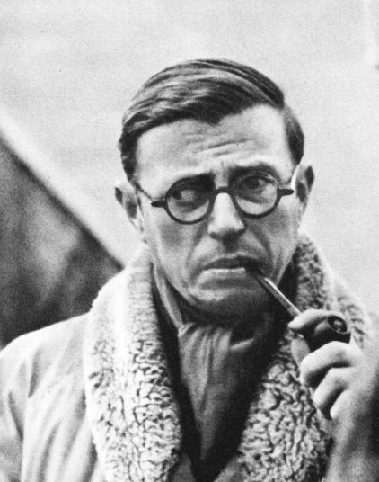
Jean-Paul Sartre (1905-1980)
Was a prisoner of war during the Nazi occupation of France → sympathetic to French resistance to fascism
Most important work is Being and Nothingness (1943) which was influenced by Heidegger’s Being and Time (1927)
War and violence in Europe → led to pessimistic account of human condition
Each person faced with choice: collaboration with Nazis, risky resistance, or quiet self-preservation

Slide 5
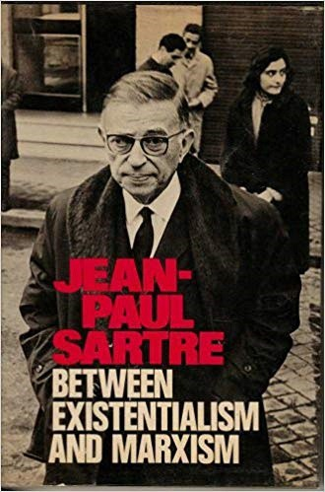
Sartre and Marxism
Devoted his life to intellectual pursuits → moved from the individualist approach in early writings and began to focus on social and class issues
Argued for a classless democratic society → necessary for true human freedom
Marxism is “the inescapable philosophy of our time” → though needed modification via existentialism
Supported Algerian independence from France and opposed US war in Vietnam
Passage 1 on handout

Slide 6
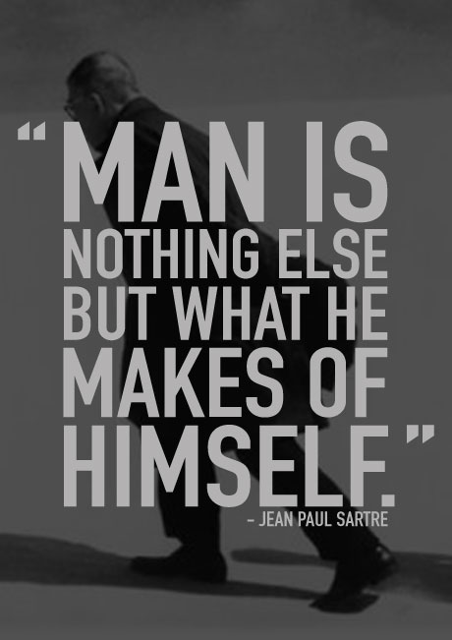
No external justification for values
Differs from the theist not just in metaphysics, but entire life view
No transcendent values set for us
No commandments from God
No Platonic Form of the Good
No meaning or purpose in human life
No Aristotelean telos
No Heavenly Father to tell us what to do
No external or objective justification for values

Slide 7
Being and Consciousness
Being-for-itself: consciousness or “human reality”
Intentional, consciousness of something distinct from subject (subject and object dualism)
Being-in-itself: inanimate, nonconscious reality
No awareness of anything, no conception of self
Sounds similar to mind/body dualism of Descartes, but it is different
Human being a unified reality
No distinguishing between two substances, but two modes of being: “the way that conscious beings exist is different from the way that inanimate things exist.”

Slide 8
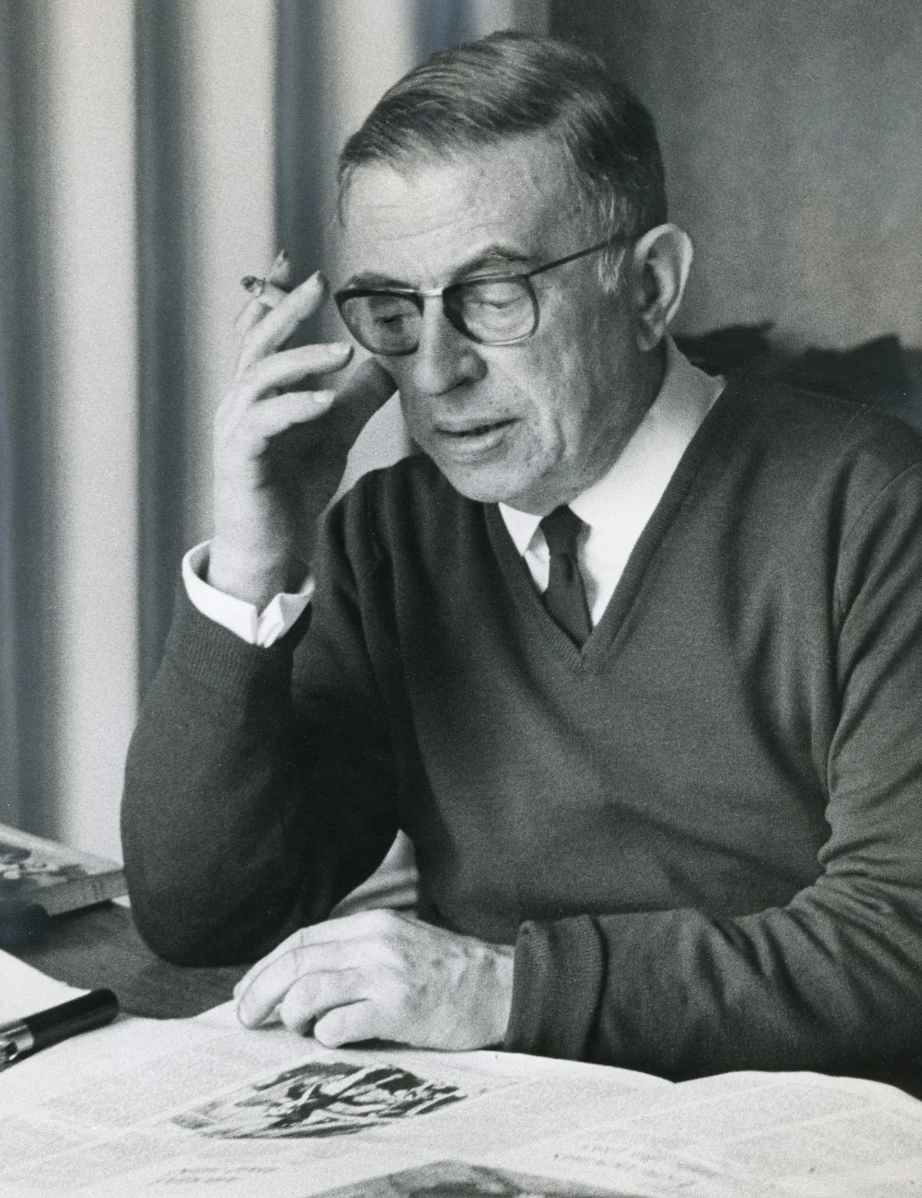
Sartre and the denial of God
Important metaphysical assertion: there is no god.
Sartre: we all desire to be God → to be our own foundation
We would like to be perfectly complete and self-justifying
We aspire to become in-itself-for-itself
In-itself-for-itself: the coming together of being-in-itself and being-for-itself

Slide 9
For-itself: the incompleteness of human experience
“The for-itself, as the locus of subjective experience, is what brings value and meaning to the universe. Without it, the universe really would be nothing more interesting than atom-sized billiard balls smacking into each other. However, there is a problem with the for-itself; namely, it lacks the certainty and ‘fullness’ that comes with being. As something as insubstantial as a perspective or a relation, it is consigned to an ambiguous existence, never attaining a ‘full’, or ‘pure’, being. It is never wholly ‘this’ or ‘that’ thing, for if it were, it would immediately cease to be consciousness and become in-itself instead”
(Nathan Hohipuha, “Sartre and Buddhism”).

Slide 10
For-itself or in-itself
The for-itself: aware of this lack
Existence is incomplete, a subject always separate from an object
Leads to alienation
Consciousness is always consciousness of something → consciousness of something other is the beginning of subject/object dualism
Incompleteness of the being of the for-itself
Should we become being-in-itself?
We would gain the certitude and completion of in-itself
But we would lose consciousness → self-annihilating
Achieved complete being but unable to know ourselves as being
Root of the desire to become in-itself-for-itself

Slide 11
Sartre and Human Nature
No stable human nature or essence that comes before individual choice: “existence precedes our essence”.
Neither scientific or religious: no god or evolutionary purpose → only what we choose
Only truth of human nature: radical freedom
Only limitation to freedom is that we can not choose to not be free
We are “condemned to be free”
Negation and nothingness:
Consciousness recognizes that it is not the object it perceives → many things are not the case and/or we lack many things
Concept of nothingness or negation → related to freedom
In order to conceive of what is not implies freedom to imagine and choose other possibilities
Consciousness is largely about desiring things to be different and conceiving things that are different → not as they are
Nothingness and negation suggests absolute freedom of mind and action

Slide 12
Against mental determinism
Rejects Freud’s mental determinism and the idea of the unconscious
Freud believed that decisions were not made using reasoned free will but were influenced by the unconscious mind
Sartre: we can choose our mental states, like emotions → as well as character traits
“I am not shy, I choose to be shy”
Radical freedom is clear when we make resolutions
I might say that I won’t eat cookies, but when the next week comes I am free to eat them → I am not constrained by my past resolution
Being confronted by choices creates angst → when we confront our freedom it brings anxiety

